Slide 1
Tatiana Lucero
CONNECTIVITY
Discrete Math CS 131
IN GRAPHS
Tatiana Lucero
A look into the practical application

Slide 2
BEFORE WE BEGIN
In this presentation I’ll be focusing on the C++ implementation of graphs and algorithms interpreting them
We’ll look at specific prompt and the algorithm needed to solve it
And then we’ll take a look at the C++ implementation of the algorithm
Discrete Math CS 131
Tatiana Lucero

Slide 3
FLIGHT CONNECTIONS
THE PROMPT
Discrete Math CS 131
Let’s say you (someone working for an airline) are working on a system to help passengers find a route from their starting airport to their destination with the least amount of connections.
You receive as input:
A list of airports
A list of connections
Starting airport
Target airport/destination
Tatiana Lucero

Slide 4
THE DETAILS
Airports: { “IST”, “FRA”, “DFW”, “ORD”, “LAX”, “CLT”, “PHX”, “MCO”, “SEA”, “MIA” }
Discrete Math CS 131
Since we are given an adjacency list (flight connections) and since we only care about connections, and not flight duration:
we know we are being asked to find the shortest path in a unweighted, directed graph.
Connections: { [“FRA”, “CLT”,] , [“MCO”, “SEA”,], [“PHX”, “DFW”,], [“LAX”, “MIA”], [“ORD”, “IST”,], [“DFW”, “MCO”,], [“PHX”, “MIA”], [“SEA”, “IST”,], [“FRA”, “LAX”,], [“LAX”, “CLT”,], [“FRA”, “DFW”,], [“IST”, “SEA”,], [“CLT”, “ORD”,], [“PHX”, “MCO”,], [“FRA”, “SEA”,], [“DFW”, “MIA”] }
Tatiana Lucero

Slide 5
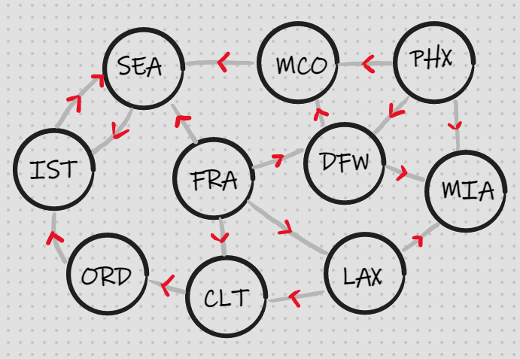
THE GRAPH
Discrete Math CS 131
Here is a visualization of the graph, our job is to, through an algorithm, find the path from our starting node S, to our final node F, in which we cross the least amount of edges.
Tatiana Lucero

Slide 6
01
THE
Discrete Math CS 131
ALGORITHM
Tatiana Lucero
How do we implement this?

Slide 7
GENERAL STEPS
01
03
02
04
bfs
path
nfs
translation & printing
Discrete Math CS 131
run an altered breadth first search as a sub-function starting from source searching for target
In BFS use list to keep track of
each verticex’s previous vertex,
(will be translated
into path)
In BFS use list to keep track of: -distance or NFS, nodes from source
Translate list and print returned values from the BFS
Tatiana Lucero

Slide 8
BREADTH FIRST SEARCH
Discrete Math CS 131
A review for those unfamiliar with the algorithm
Tatiana Lucero
node and vertex will be used practically interchangeably

Slide 9
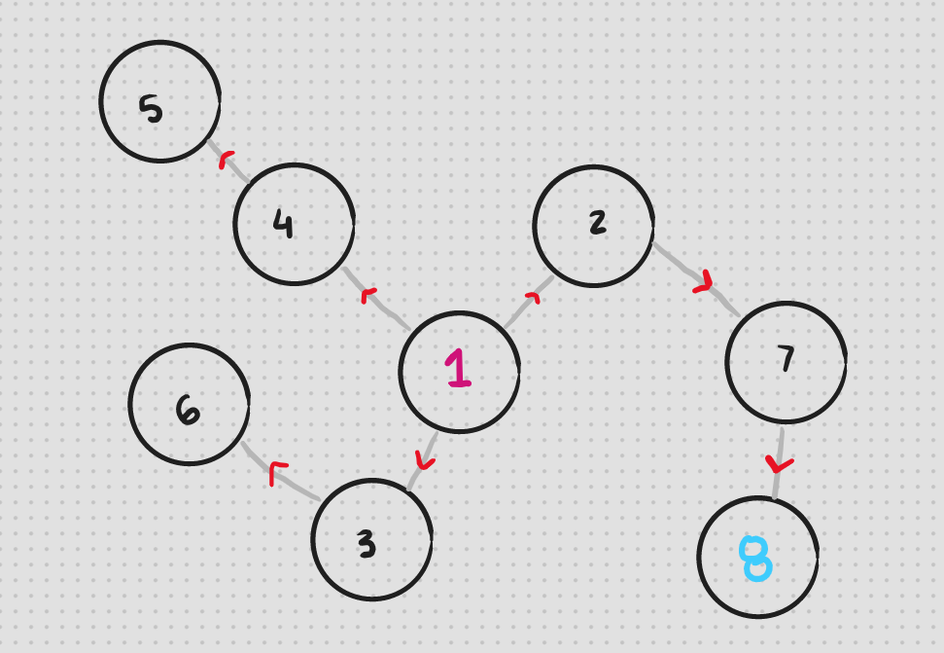
OVERVIEW
A Breadth First Search starts from the source node visiting each of the sibling nodes before the child nodes
time complexity of O(v+e), vertices & edges
Each iteration, the queue data structure stores a visited vertex’s child nodes to visit them in the next iteration.
Discrete Math CS 131
Here’s an example of a graph
let’s say we’re start at node 1,
searching for node 8,
visited nodes will be highlighted, and we’ll keep track of what our queue looks like
Tatiana Lucero

Slide 10
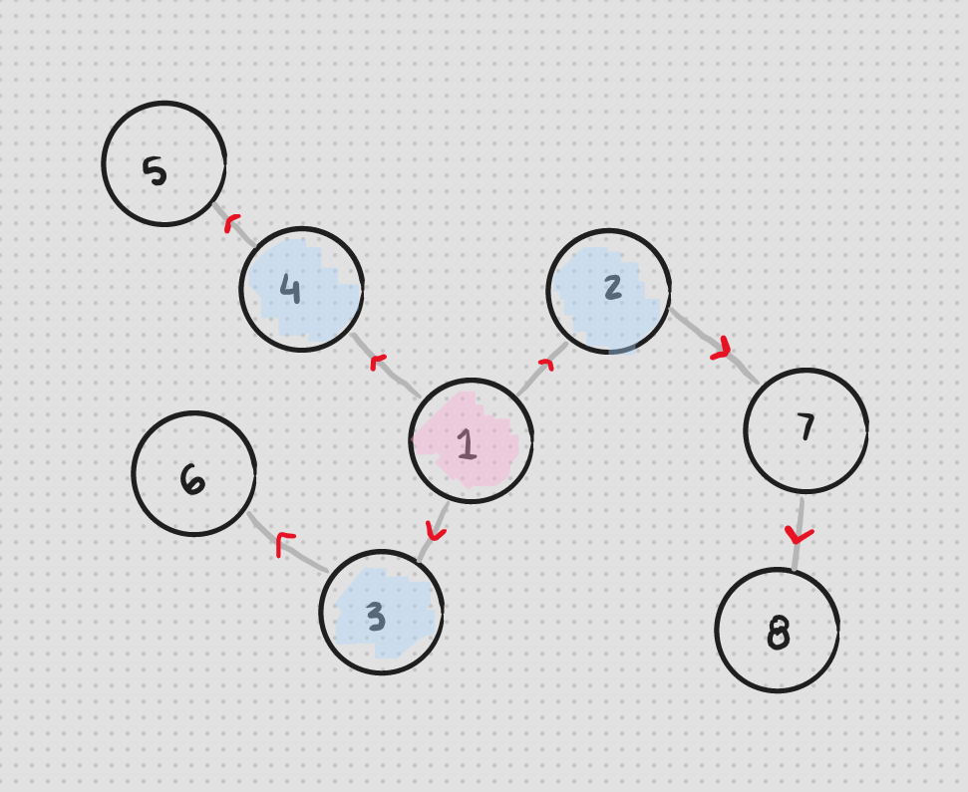
BREADTH FIRST SEARCH
First step:
-We add 1 to our queue, then visit it
adding it’s child nodes into the queue:
4, 2, 3
2nd step:
-using our queue: 4, 2, 3 we visit each node (one by one) adding their child nodes into the queue to visit in the next step.
-the queue that was: 4, 2, 3 becomes:
2, 3, 5, → 3, 5, 7, → 5, 7, 6
And our visited nodes are now:
1, 4, 2, 3
Discrete Math CS 131
Tatiana Lucero
Starting node: 1, Final node: 8
once a node has been visited we remove it from the queue

Slide 11
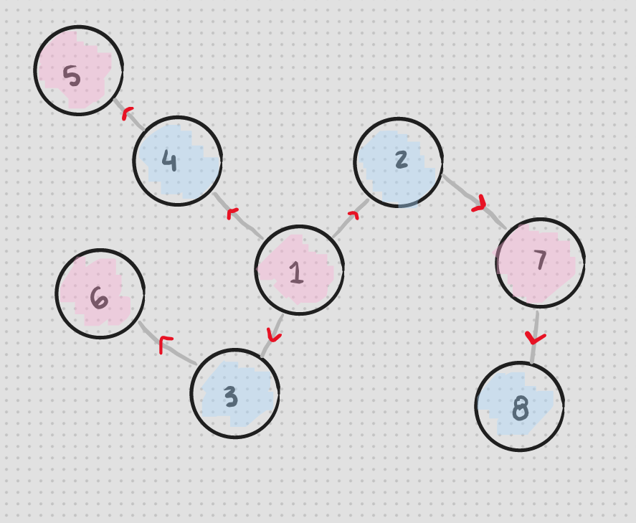
BREADTH FIRST SEARCH (CONT’D)
3rd (and final) step:
using our queue: 5, 7, 6
-we visit 5 and our queue becomes:
7, 6
(nothing gets added to the queue since 5 has no child nodes)
our visited nodes are now:
1, 4, 2, 3, 5
-then we visit 7 which has 8 as the child node, our final node, ending our search.
Discrete Math CS 131
Tatiana Lucero
Starting node: 1, Final node: 8

Slide 12
ALTERED BFS
Discrete Math CS 131
What we’re keeping track of during the BFS
Tatiana Lucero
This is combining steps 2 and 3 from the “general steps”

Slide 13
THE TWO LISTS
In the regular bfs we use:
q & visited[]
-a queue data structure, e/a iteration we visit the node listed on top,
-a bool list keeping track if a node has been visited, each iteration we check if the node on top of the queue has been visited before we add their child nodes to the queue.
Discrete Math CS 131
In this altered bfs, we’re going to
add two lists:
nfs[]
assigns e/a node we visit a distance, nodes from source, nfs
previousNode[]
Assigns e/a node a previous node. once the target node has been found we backtrack to the shortest path from the final node to the source.
Tatiana Lucero

Slide 14
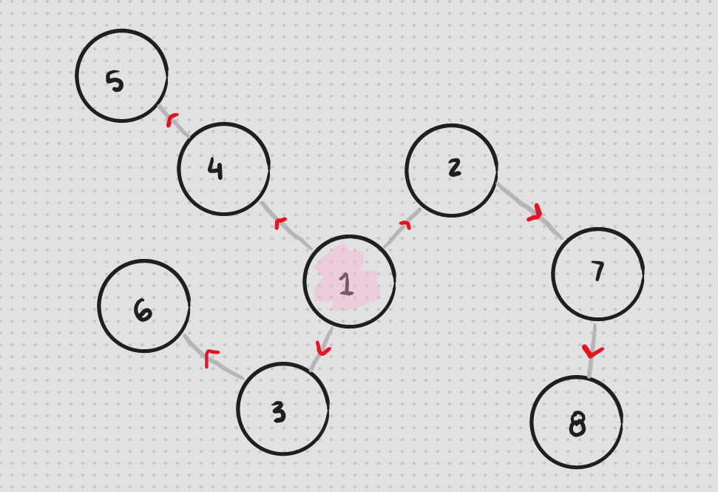
USING OUR EXAMPLE FROM EARLIER
Before we start:
We go through all the nodes with a for loop giving them all:
-a visited[] value of false
-an nfs[] value of 100 (null)
-a previousNode[] value of -1 (null)
We also:
-add 1 to our queue
-assign it an nfs[] of 0 then visit it,
Discrete Math CS 131
Starting node: 1, Final node: 8
First step:
we add it’s child nodes into the queue: 4, 2, 3 and assign e/a:
-a previousNode[] value of 1, their previous node,
-an nfs[] of 1 : 1 + 0 (one plus the nfs of their previous node).
Tatiana Lucero

Slide 15
ALTERED BFS: STEP 2
2nd step:
using our queue: 4, 2, 3 we visit each node (one by one) and:
-add their child nodes into the queue
-assign e/a child node their respective:
previousNode[] values
nfs[] values (1 + the previous’ nfs value.)
Discrete Math CS 131
-the queue that was: 4, 2, 3 becomes:
2, 3, 5, → 3, 5, 7, → 5, 7, 6 w/
previousNode[5]= 4, nfs[5]= 2
previousNode[7]= 2, nfs[7]= 2
previousNode[6]= 3, nfs[6]= 2
-our visited nodes are now: 1, 4, 2, 3
Starting node: 1, Final node: 8
Tatiana Lucero

Slide 16
ALTERED BFS: STEP 3
3rd (and final) step:
using our queue: 5, 7, 6 :
-we visit 5 and our queue becomes: 7, 6
-nothing gets added to the queue since 5 has no child nodes,
-similarly we have no new nodes to set a previousNode[] and nfs[] value for)
our visited nodes are now:
1, 4, 2, 3, 5
Discrete Math CS 131
Tatiana Lucero
-then we visit 7 which has 8 as it’s child node, our final node, and before ending our search:
We set previousNode[8] to 7 and nfs[8] to 1+nfs[7], 3

Slide 17
TRANSLATING
Discrete Math CS 131
AND PRINTING
Tatiana Lucero

Slide 18
INTERPRETING RETURNED VALUES
Translating the path
Printing
Discrete Math CS 131
Since previousNode[1] was set to negative 1, we’ll use previousNode[] != -1 as a parameter for a while loop.
In the loop starting w/ the final node, we’ll use the list to backtrack and put the nodes in reverse order into a new list, p[] to print the shortest path easily.
Using p[], the new list, we’ll simply use a for loop with a space between each node to print the path
And the number of edges crossed will be nfs[8], the nodes from source of the final node.
Tatiana Lucero

Slide 19
NOW APPLYING THE ALGORITHM TO OUR PROMPT
Discrete Math CS 131
We’ll say our starting location is FRA and our target destination is IST
Tatiana Lucero

Slide 20
ACKNOWLEDGEMENT
Discrete Math CS 131
Writing and illustrations: me, Tatiana Lucero
For my implementation I referenced but did not copy the graph class and bfs algo detailed by my data structures textbook:
D. S. Malik - C++ Programming_ Program Design Including Data Structures-Cengage
The prompt was inspired by a coding interview video I saw a while ago:
Google Coding Interview With A High School Student
By: Clément Mihailescu
Tatiana Lucero

